Slide 1
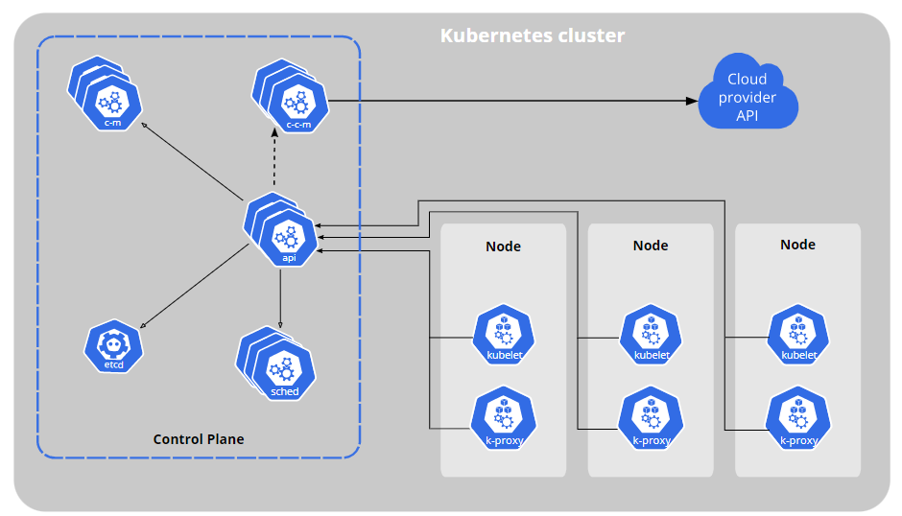
What is Kubernetes
Kubernetes is an open-source system for automation deployment, scaling, and management of containerized applications

Slide 2
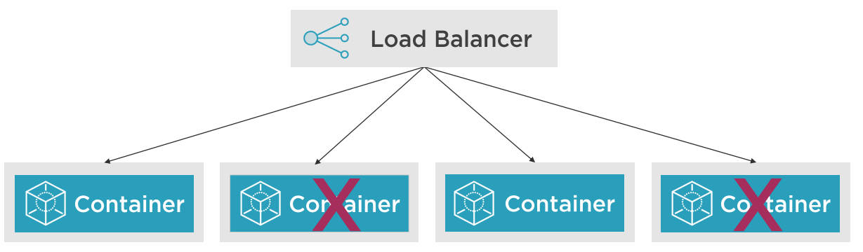
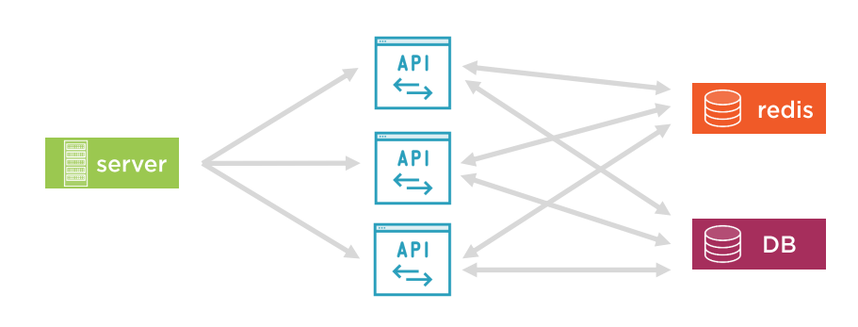
How are you managing containers?

Slide 3
Kubernetes Features
Service Discovery / Load Balancing
Storage Orchestration
Automate Rollouts / Rollbacks
Self-Healing
Secret and configuration management
Horizontal scaling

Slide 4
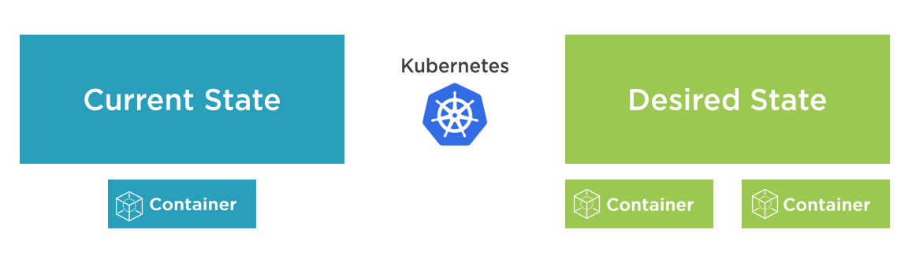
Kubernetes move you to a desired state

Slide 5
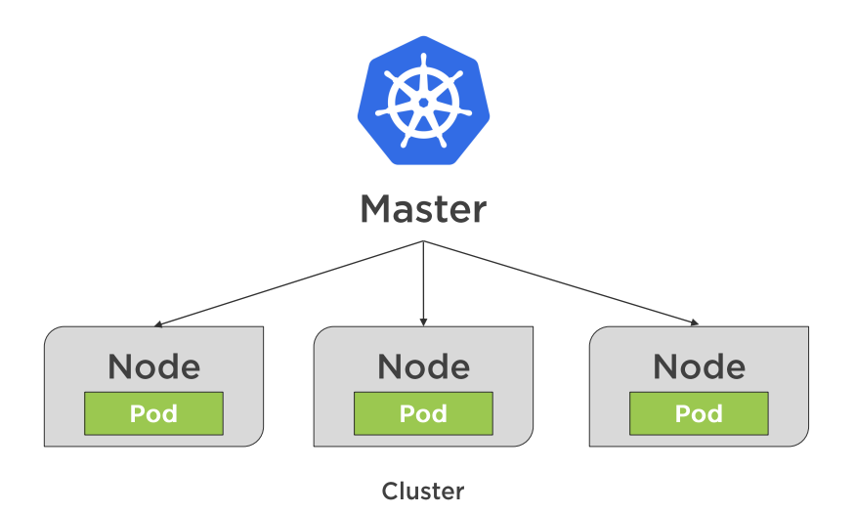
Key Elements

Slide 6
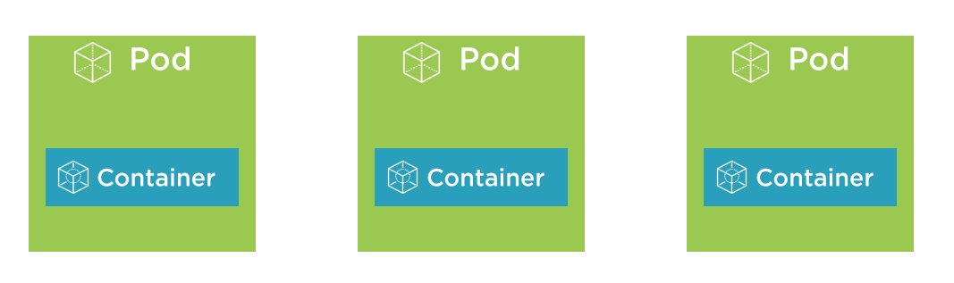
Pods and containers

Slide 7
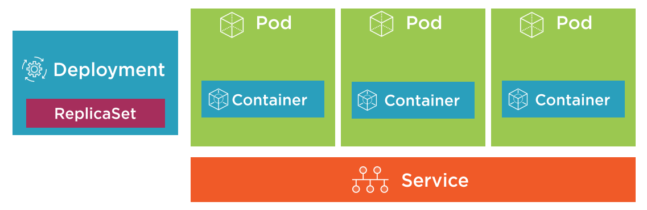
Kubernetes building blocks

Slide 8
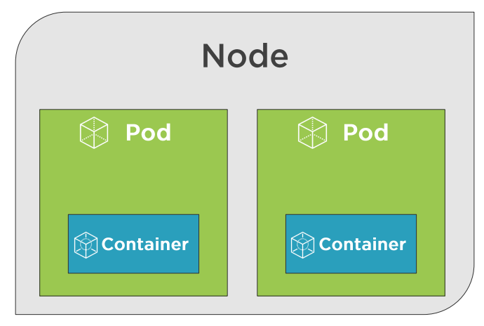
Pods and nodes

Slide 9
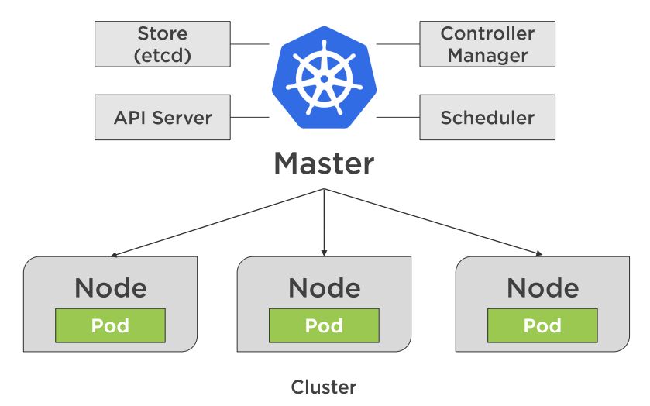
The master node

Slide 10
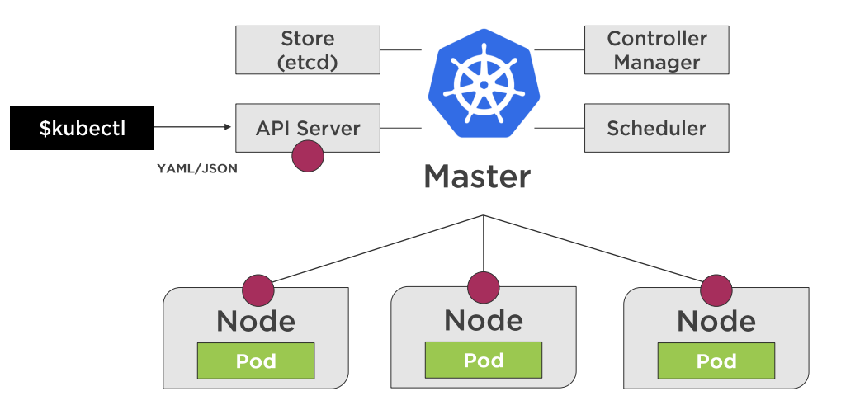
Communicating with kubectl

Slide 11
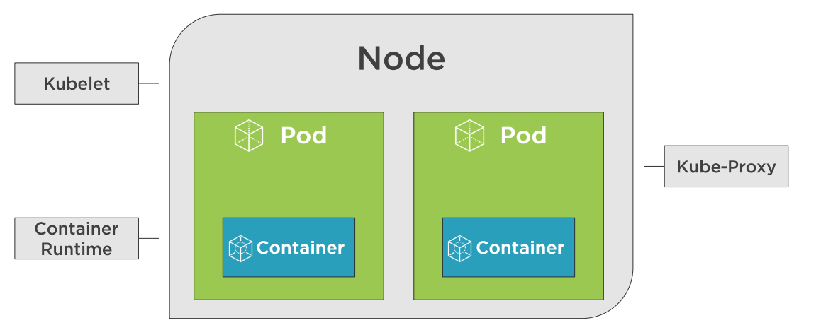
Kubernetes nodes

Slide 12
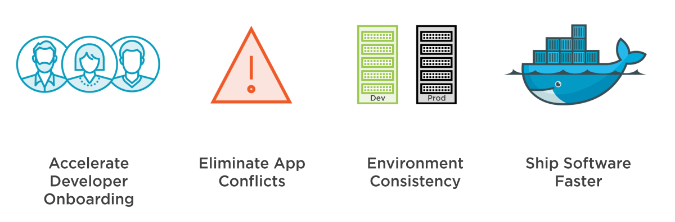
Benefits

Slide 13
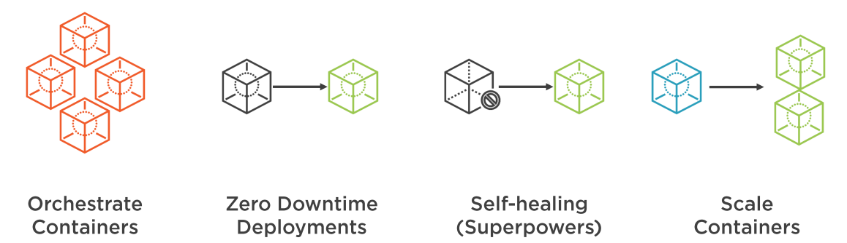
Benefits

Slide 14
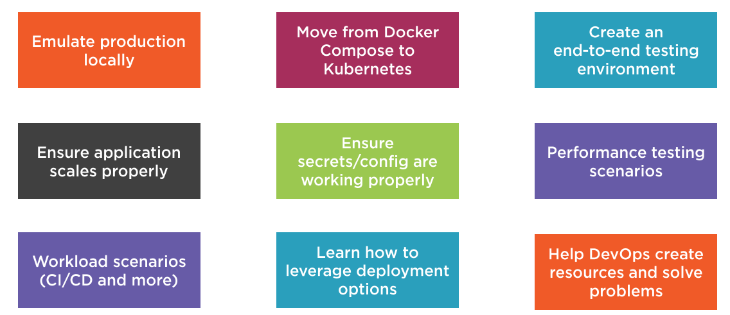
Developer Use cases

Slide 15
Running Kubernetes Locally
DEMO

Slide 16
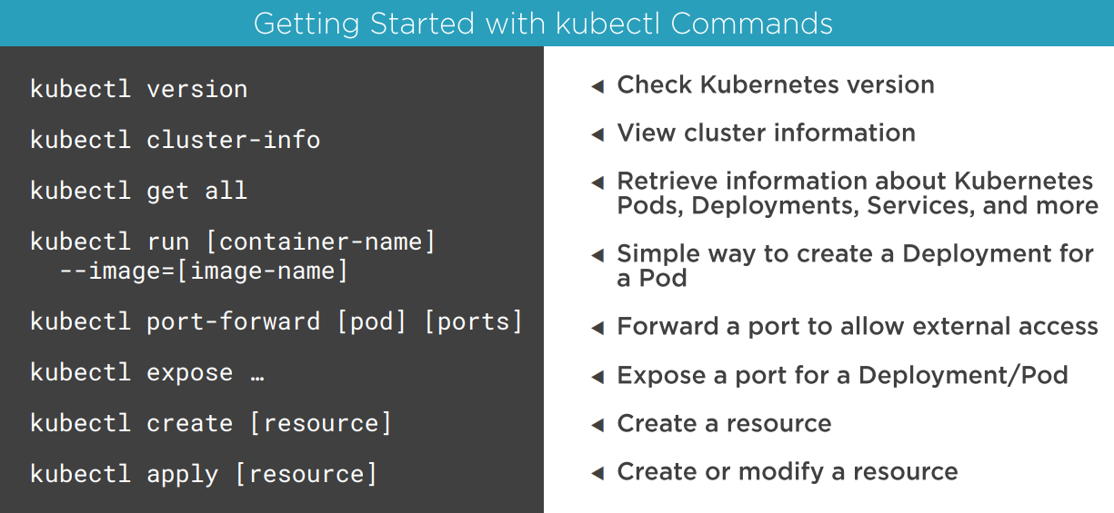

Slide 17
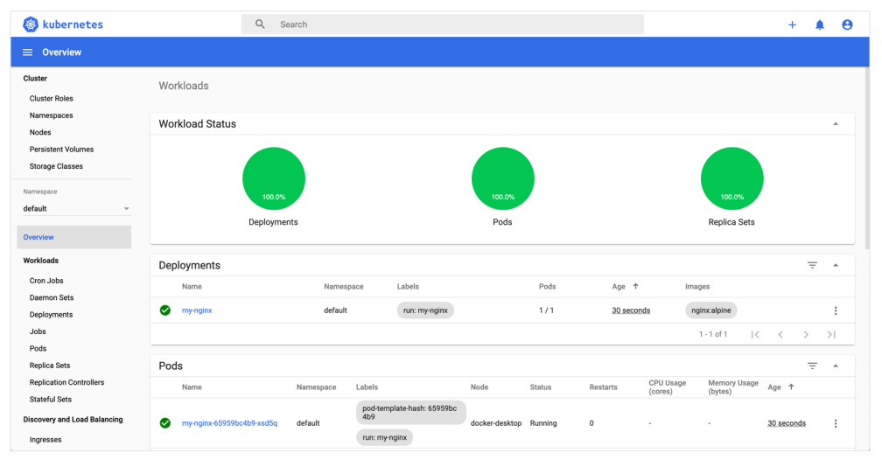
Web UI Dashboard

Slide 18
Pods
A pod is the basic execution unit of a Kubernetes application – the smallest and simplest unit in the Kubernetes object model that you create or deploy

Slide 19
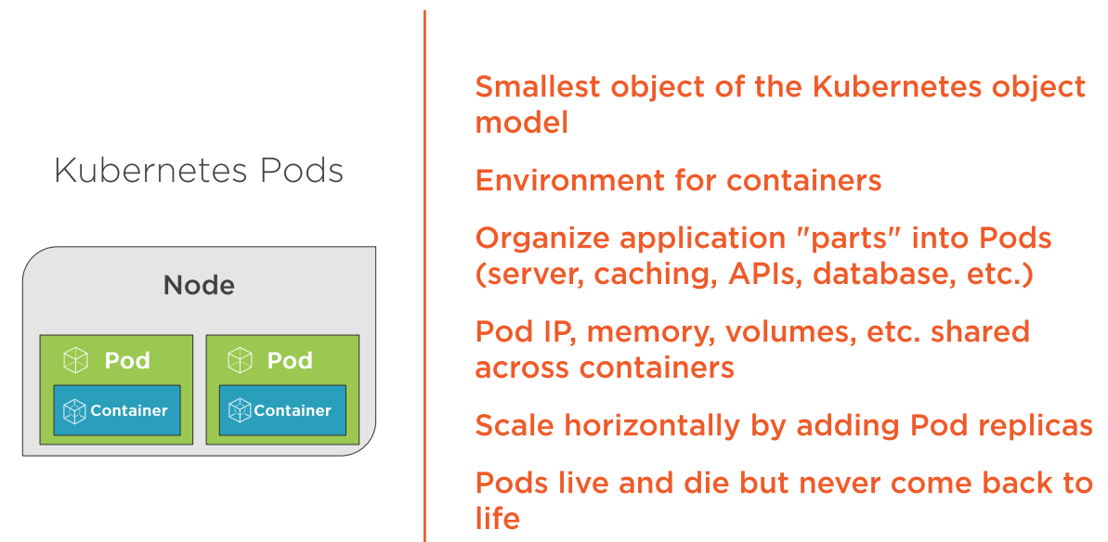
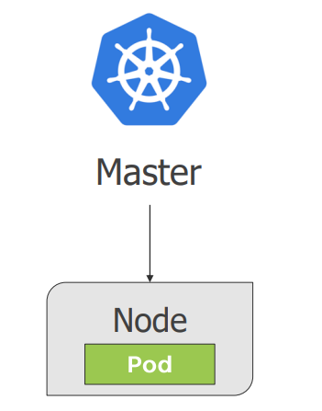
Pods

Slide 20
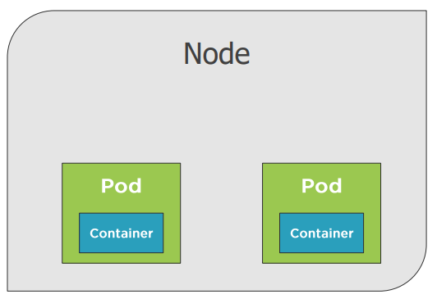
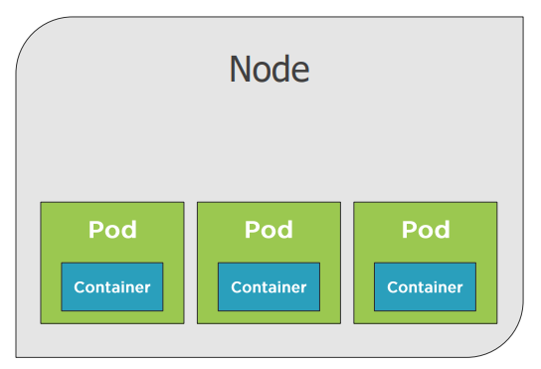
Pods

Slide 21
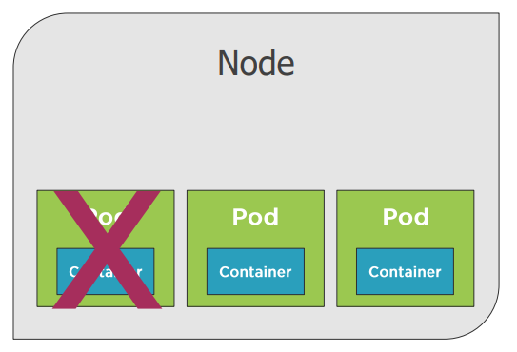
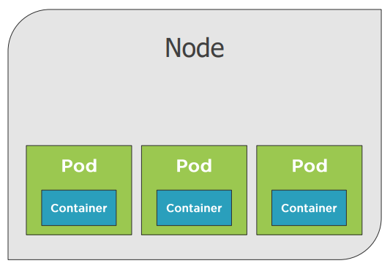
Pods

Slide 22
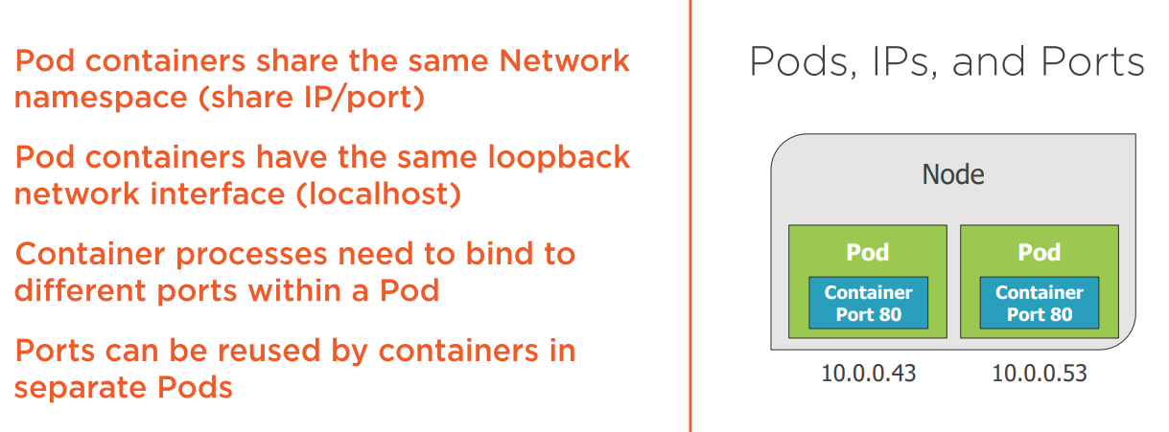
Pods

Slide 23
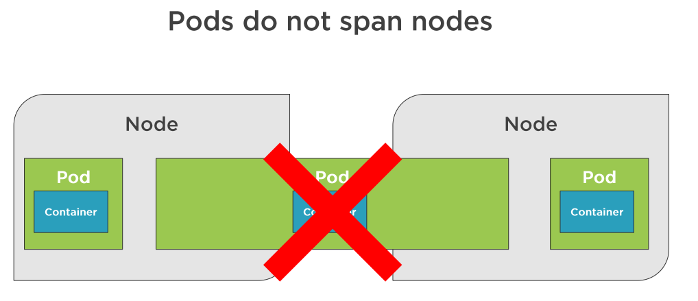
Nodes and Pods

Slide 24
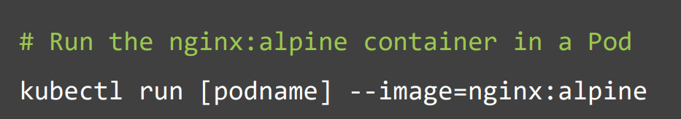
Running a Pod
Kubectl run
Kubectl create/apply

Slide 25
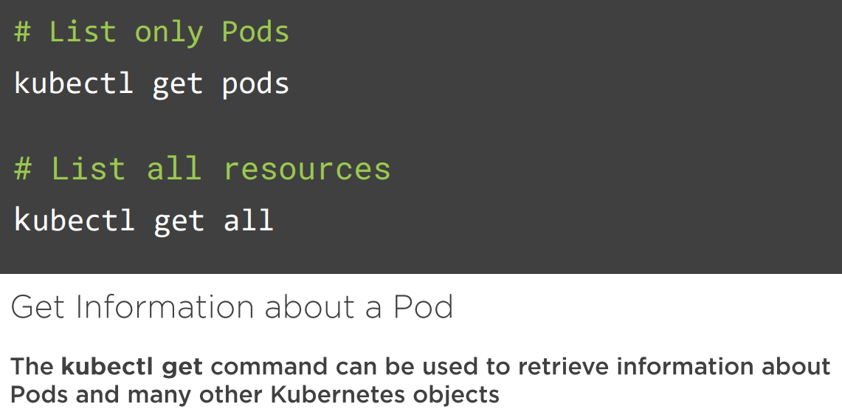
Information about Pod

Slide 26
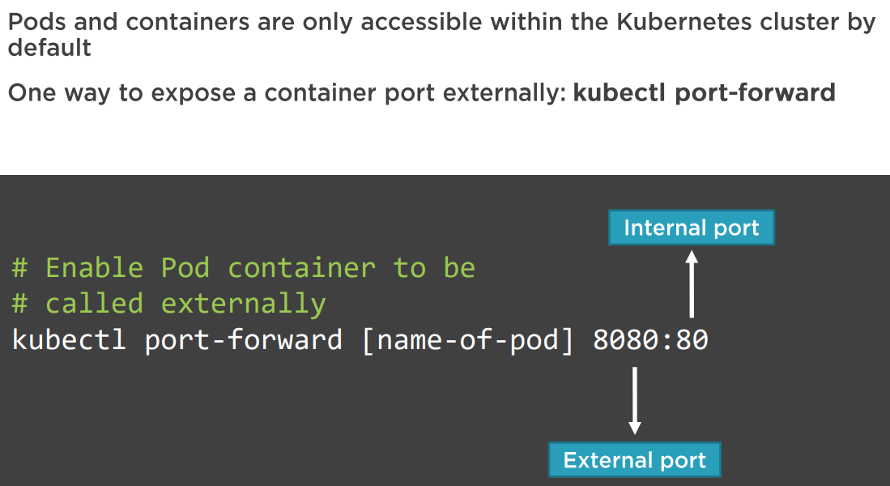
Expose a Pod port

Slide 27
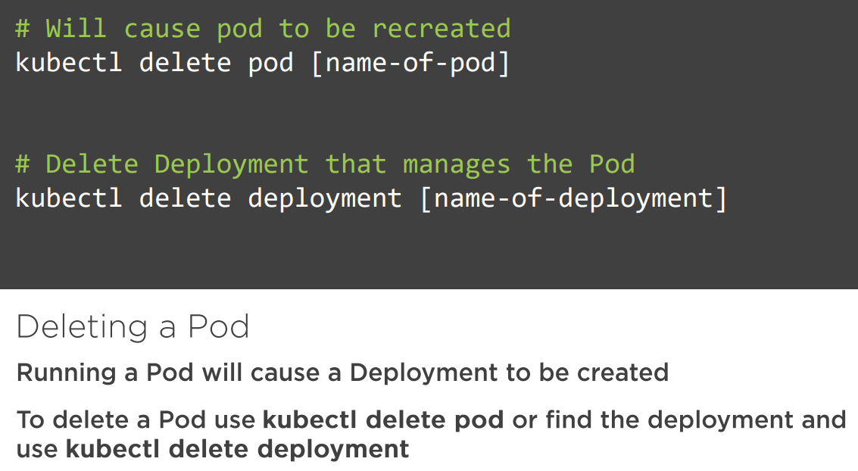
Deleting a pod

Slide 28
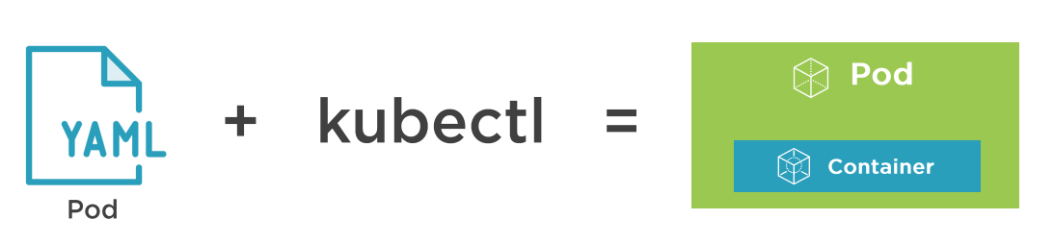
Defining a pod with YAML

Slide 29
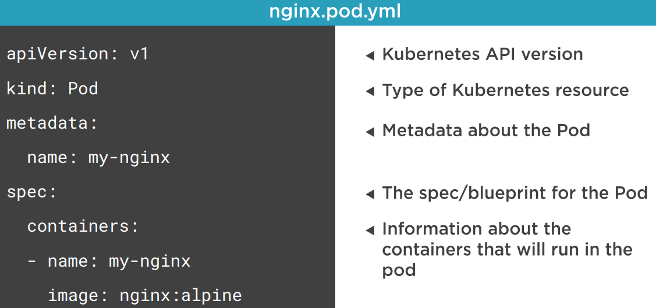

Slide 30
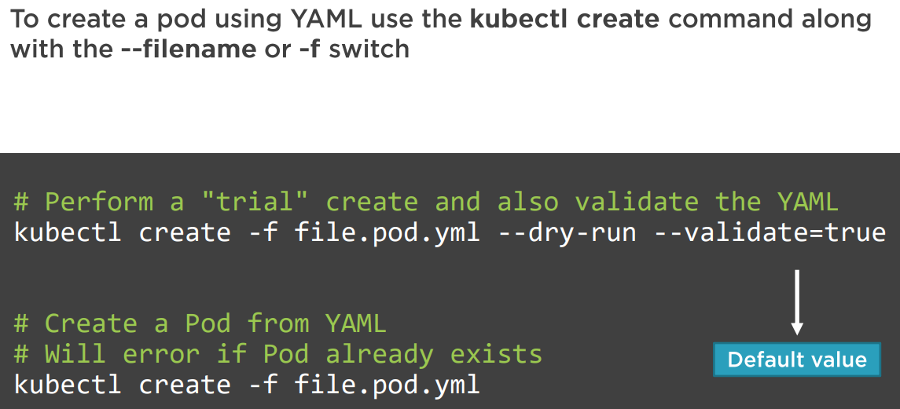
Creating a Pod using YAML

Slide 31
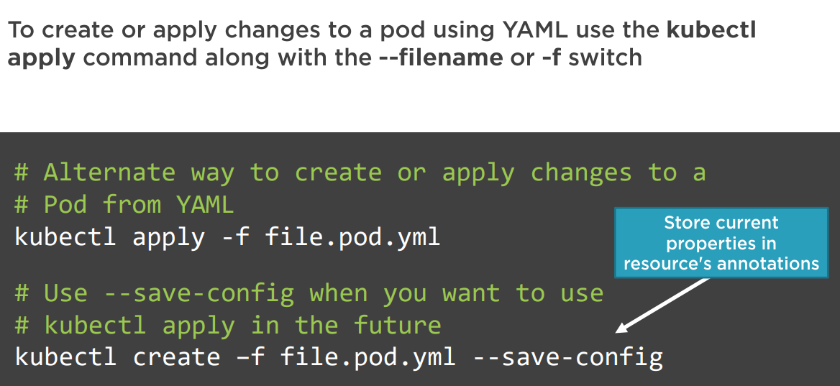
Creating or applying changes to a Pod

Slide 32
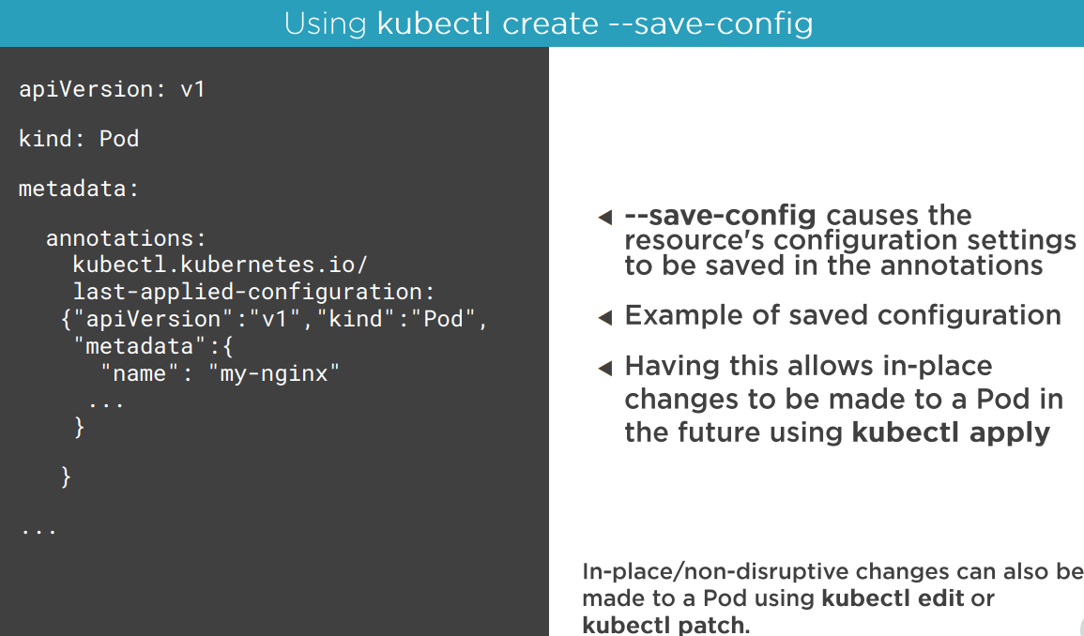

Slide 33
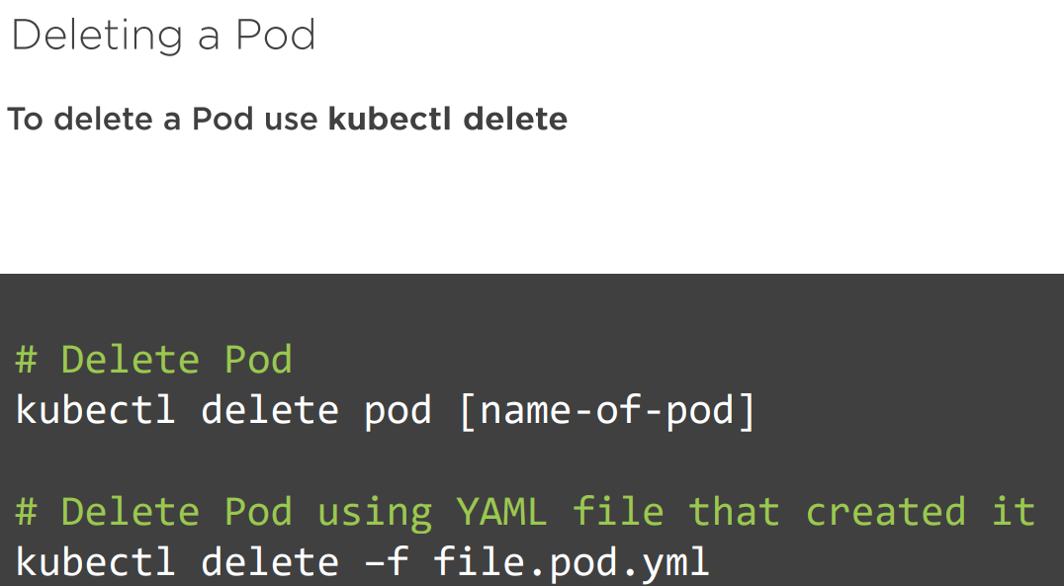
Deleting a Pod

Slide 34
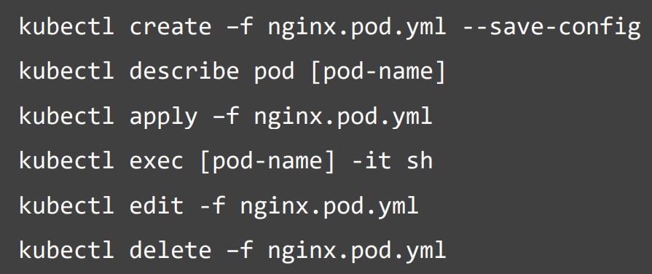
Creating and Inspecting Pods with kubectl

Slide 35
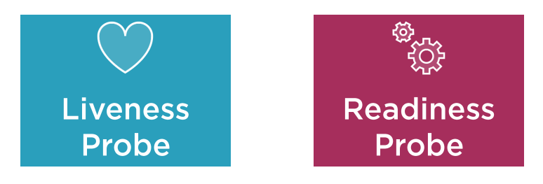
Pod Health
Kubernetes relies on Probes to determine the health of a Pod container
A probe is a diagnostic performed periodically by the kubelet on a container

Slide 36
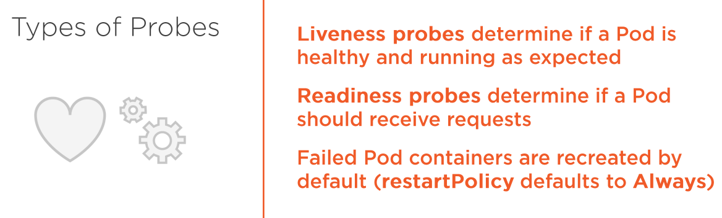
Types of Probes

Slide 37
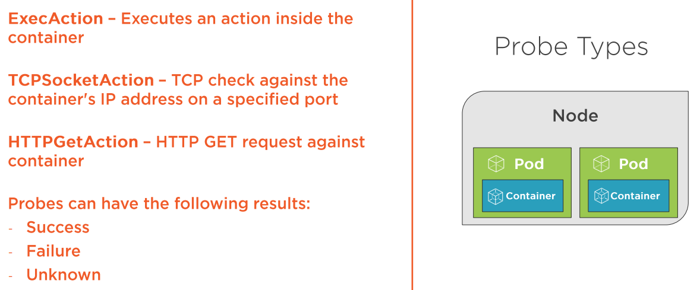
Probe types

Slide 38
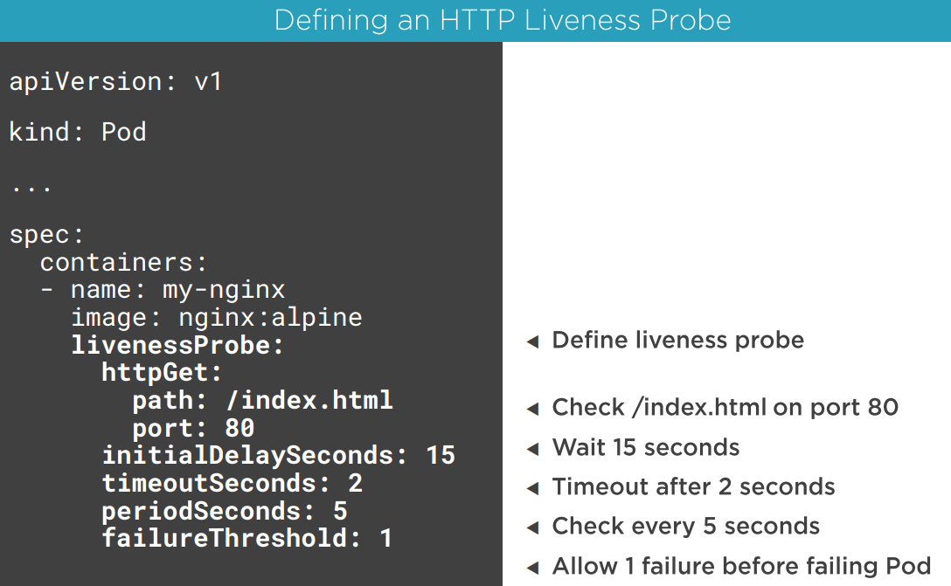
Probe types

Slide 39
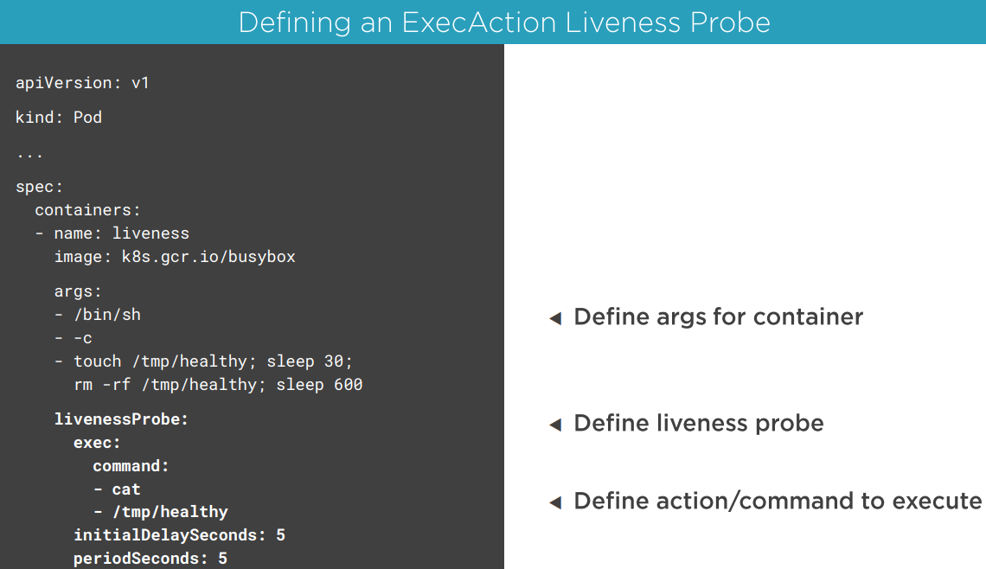
Probe types

Slide 40
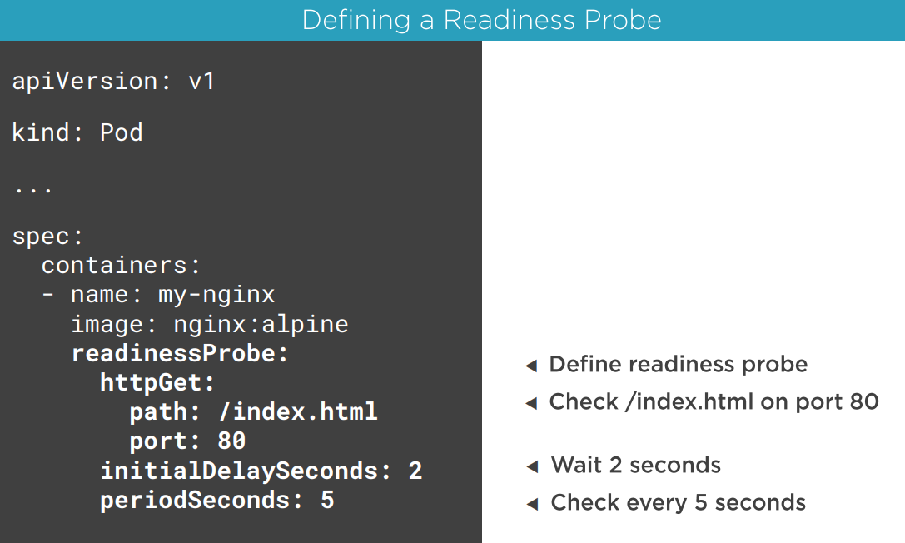
Probe types

Slide 41
Deployments
A ReplicaSet is a declarative way to manage Pods
A Deployment is a declarative way to manage Pods using a ReplicaSet

Slide 42
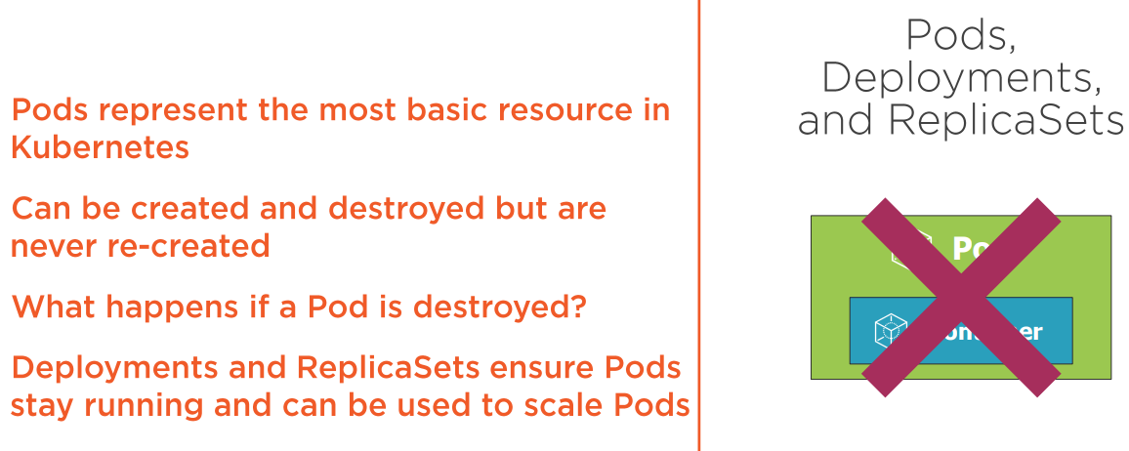
Deployments

Slide 43
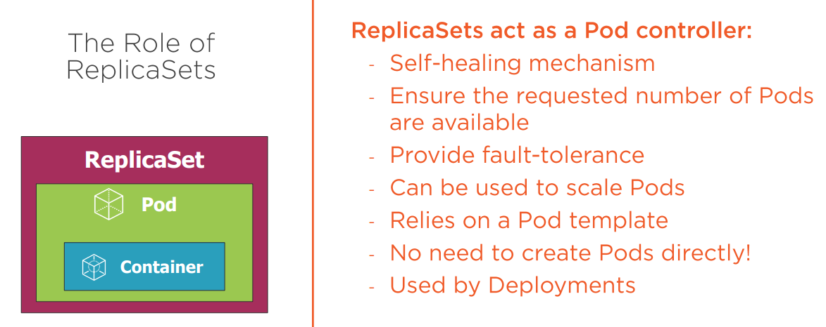
ReplicaSet

Slide 44
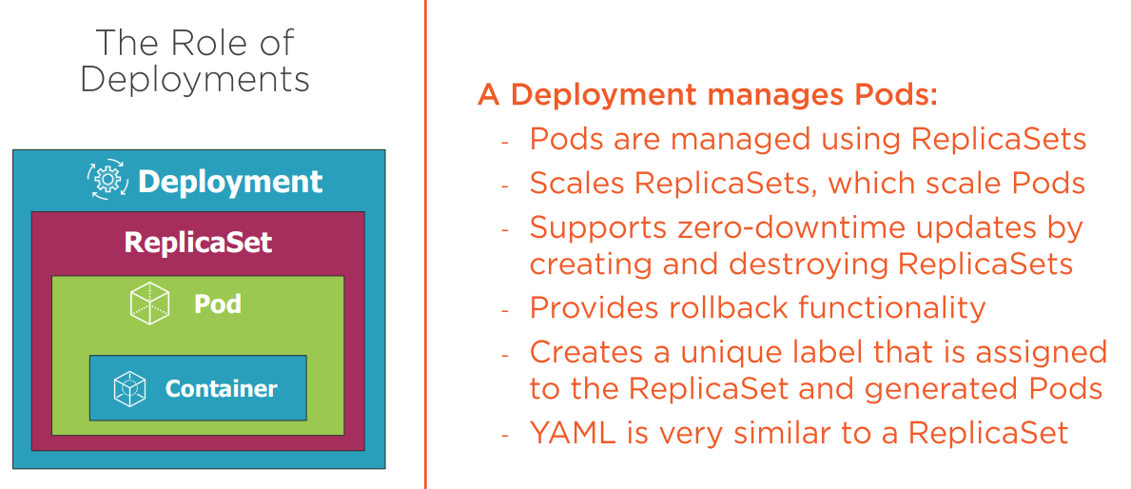
Deployments

Slide 45
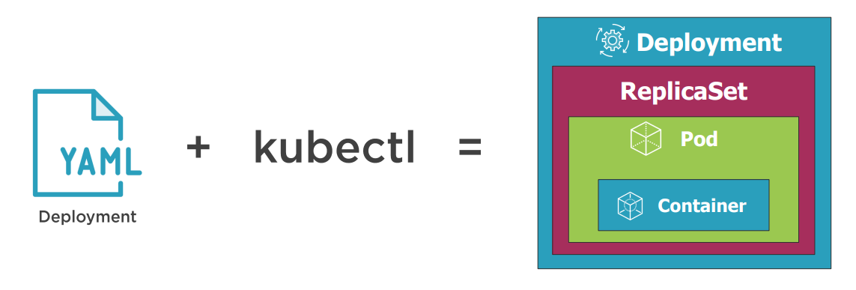
Defining a Deployment with YAML

Slide 46
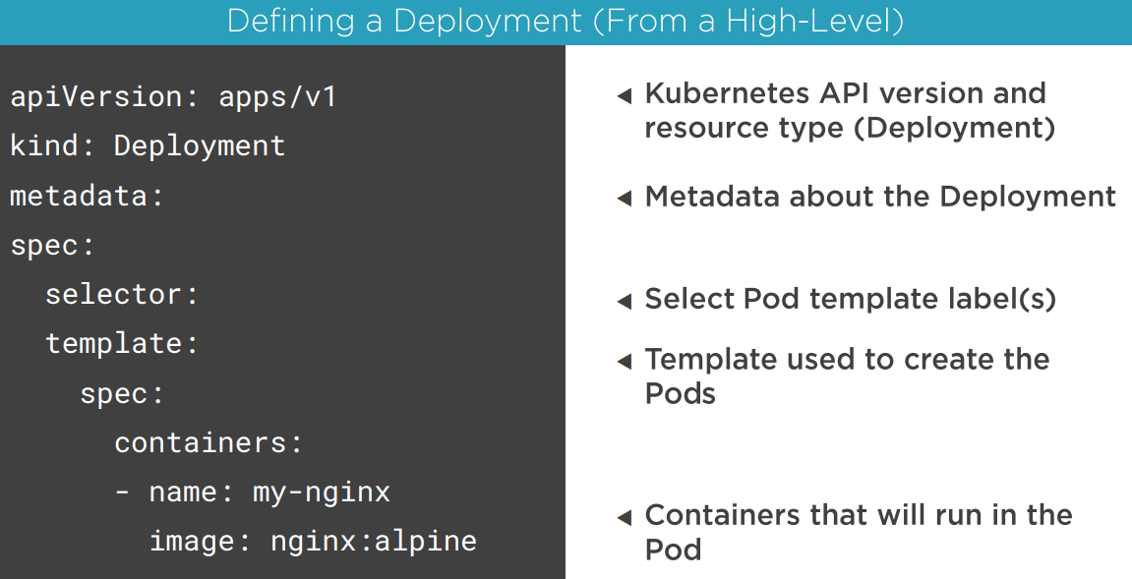

Slide 47
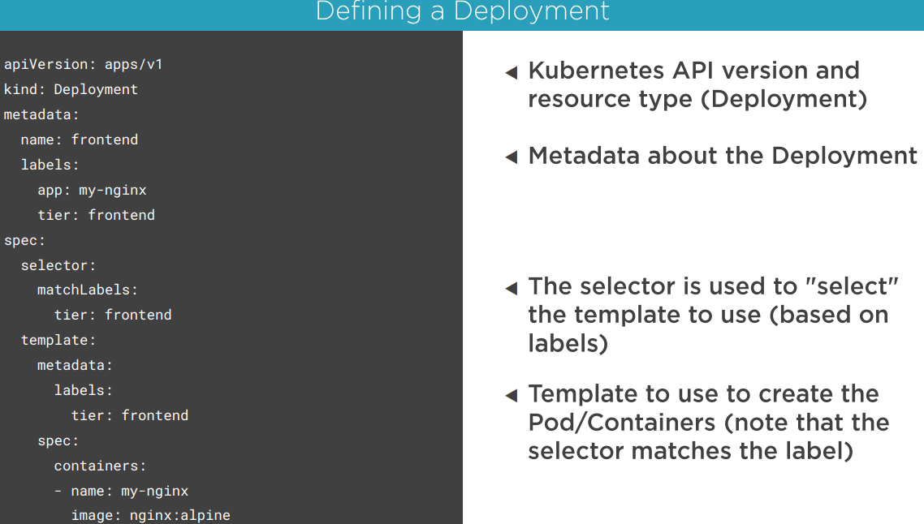

Slide 48
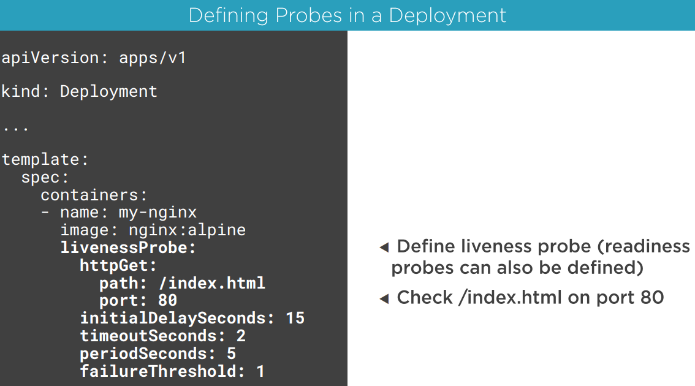

Slide 49
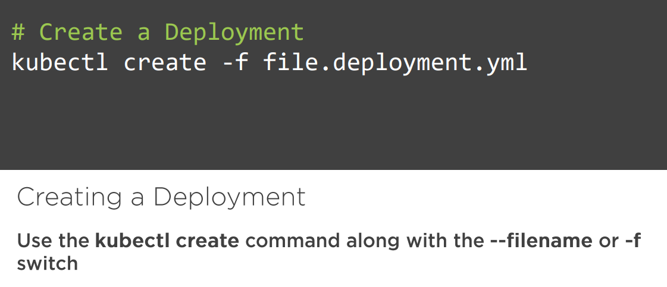

Slide 50
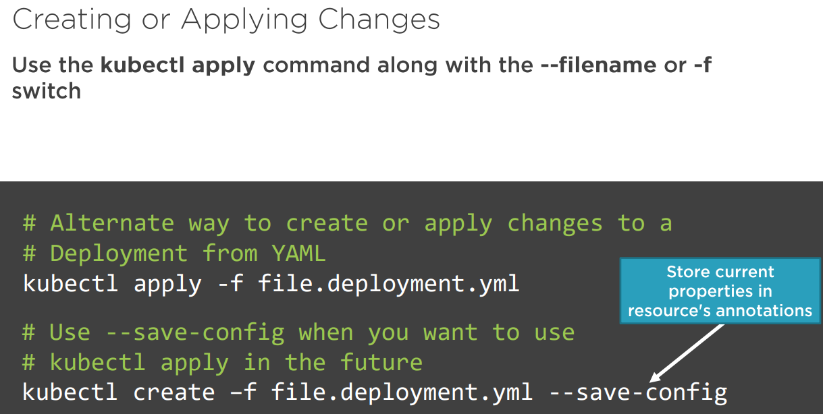

Slide 51


Slide 52


Slide 53


Slide 54


Slide 55

How do you update existing pods?

Slide 56


Slide 57




Rolling deployments

Slide 58

Services
A service provides a single point of entry for accessing one or more Pods

Slide 59


Slide 60


Slide 61

Calling services

Slide 62

Services and Pod Load Balancing

Slide 63

Service Types

Slide 64

ClusterIP Service

Slide 65

NodePort Service

Slide 66

LoadBalancer Service

Slide 67

ExternalName Service

Slide 68


Slide 69


Slide 70


Slide 71


Slide 72


Slide 73


Slide 74


Slide 75


Slide 76


Slide 77


Slide 78


Slide 79

Storage
A volume can be used to hold data and state for Pods and containers

Slide 80


Slide 81


Slide 82


Slide 83


Slide 84


Slide 85


Slide 86


Slide 87
PV & PVC
A PersistentVolume (PV) is a cluster-wide storage unit provisioned by an administrator with a lifecycle independent from a pod
A PersistentVolumeClaim (PVC) is a request for a storage unit (PV)

Slide 88


Slide 89






Slide 90


Slide 91


Slide 92


Slide 93

StorageClass
A StorageClass (SC) is a type of storage template that can be used to dynamically provision storage

Slide 94


Slide 95


Slide 96


Slide 97


Slide 98

ConfigMaps
ConfigMaps provide a way to store configuration information and provide it to containers

Slide 99


Slide 100


Slide 101


Slide 102


Slide 103


Slide 104


Slide 105


Slide 106


Slide 107


Slide 108
Secret
A secret is an object that contains a small amount of sensitive data such as a password, a token, or a key

Slide 109


Slide 110


Slide 111


Slide 112


Slide 113


Slide 114


Slide 115


